Slide 1
Successful Marketing Strategies
Tyler Smith, Idaho
Travis Beck, Nebraska

Slide 2
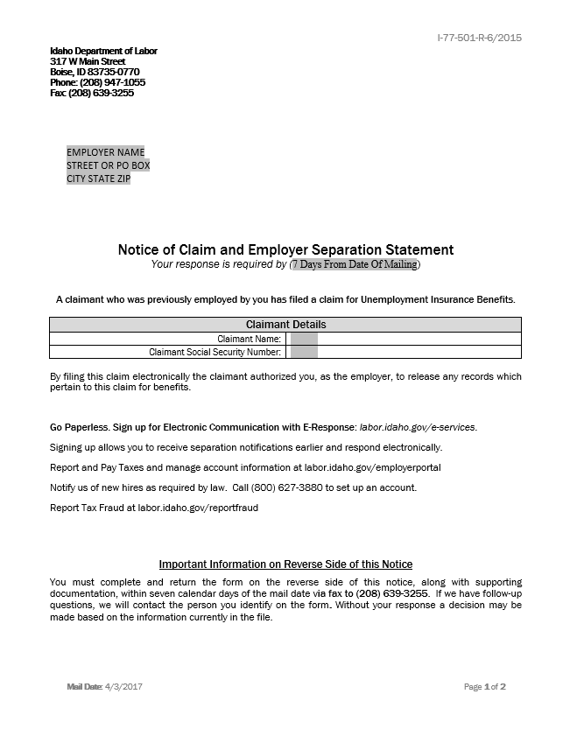
Paper Notifications

Slide 3
Paper Notifications

Slide 4
Inserts in Decisions

Slide 5
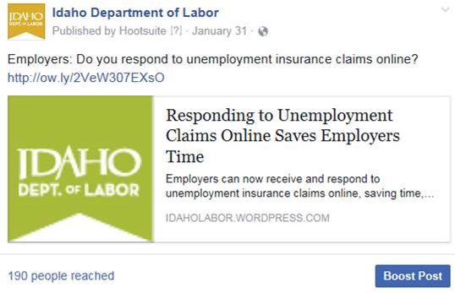
Social Media Posts
Idaho

Slide 6
Social Media Posts
Kansas

Slide 7
Newspaper Ads

Slide 8
Employer Booklets

Slide 9
Workshop Handouts

Slide 10
Business Cards

Slide 11
YouTube Video
SIDES E-Response

Slide 12
Required Business Posters

Slide 13
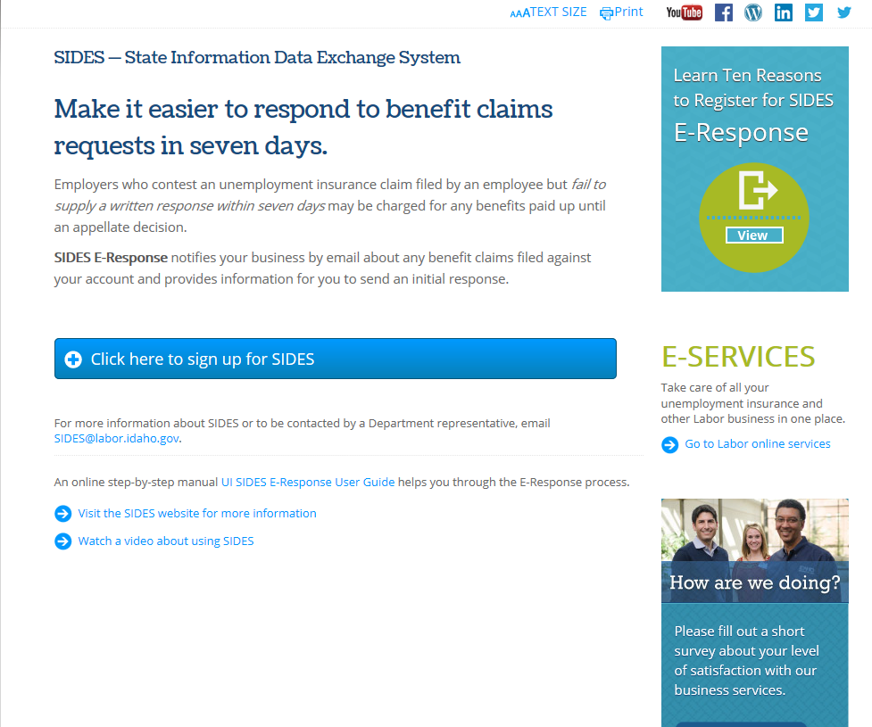
Electronic Registration
www.labor.Idaho.gov/sides

Slide 14
Electronic Registration

Slide 15
Other State examples?

